Slide 1

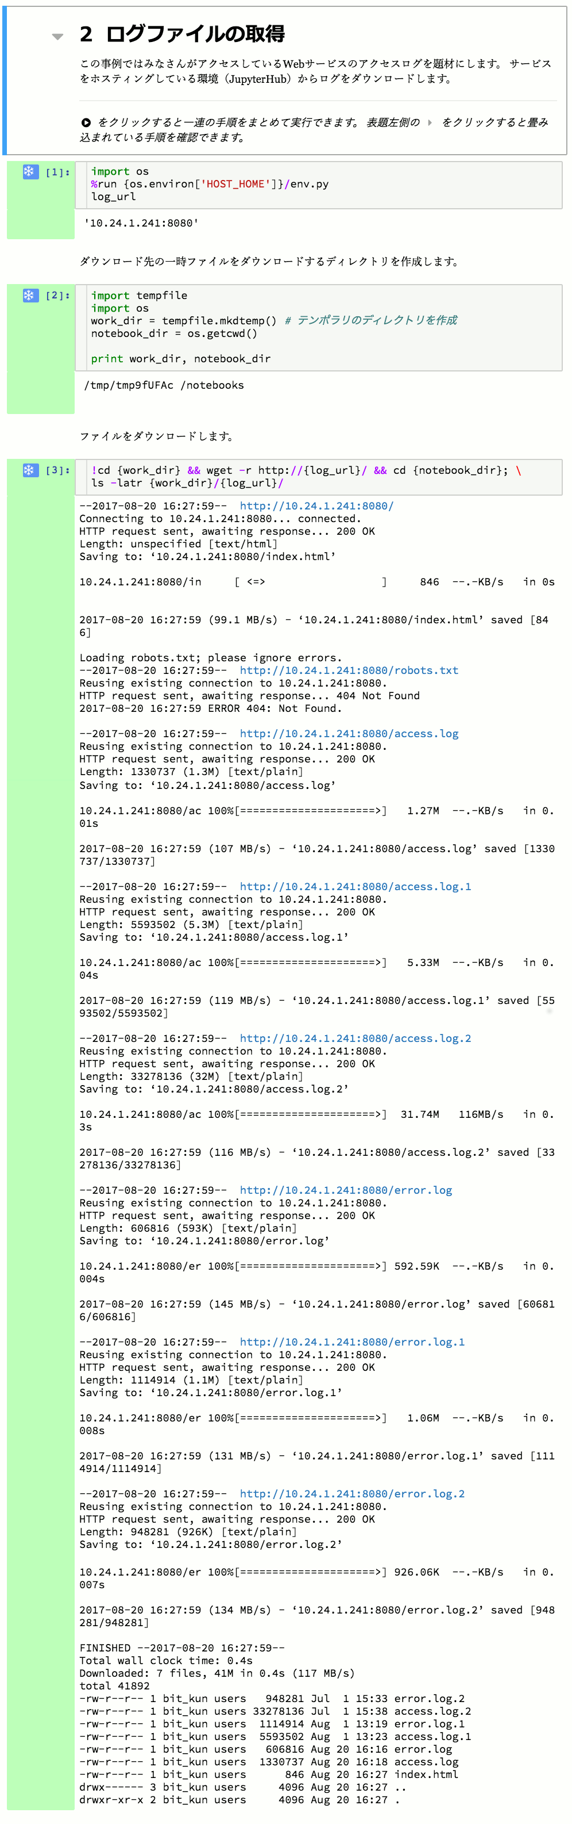
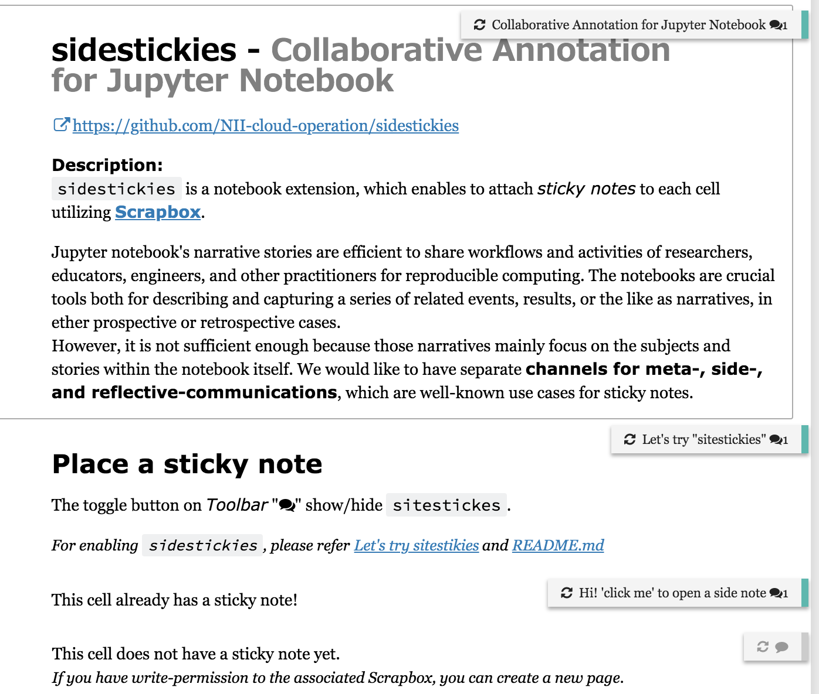
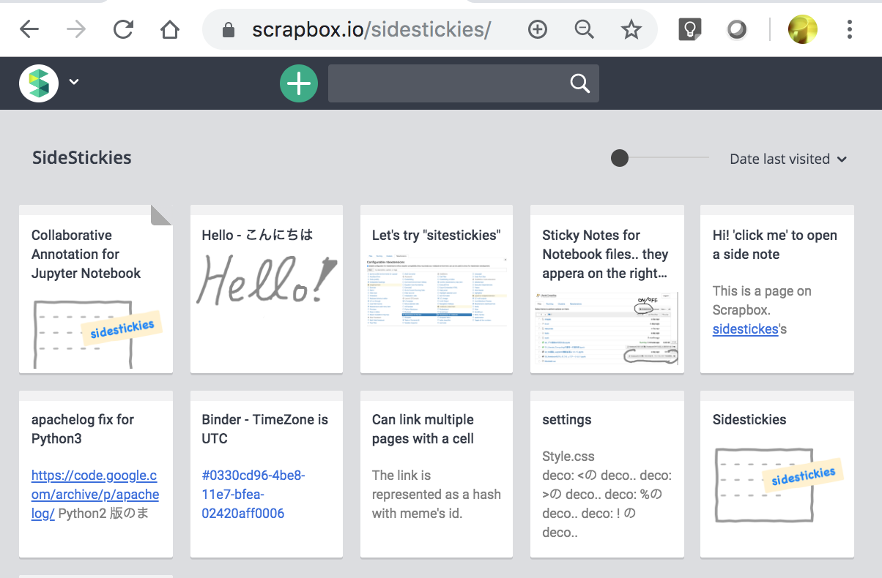

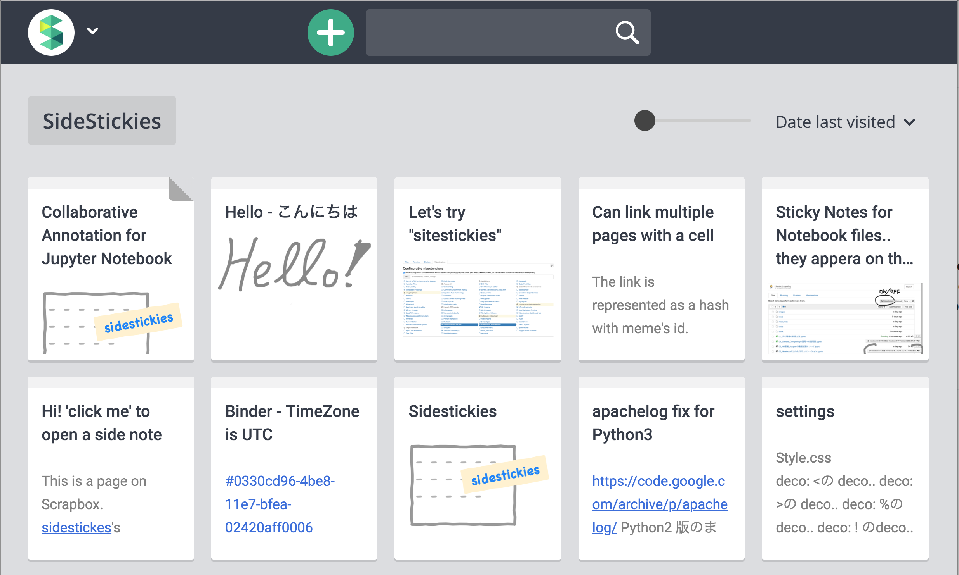
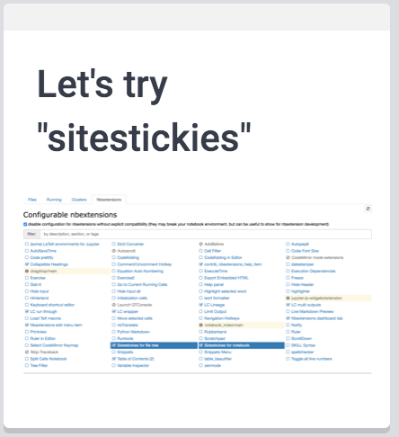
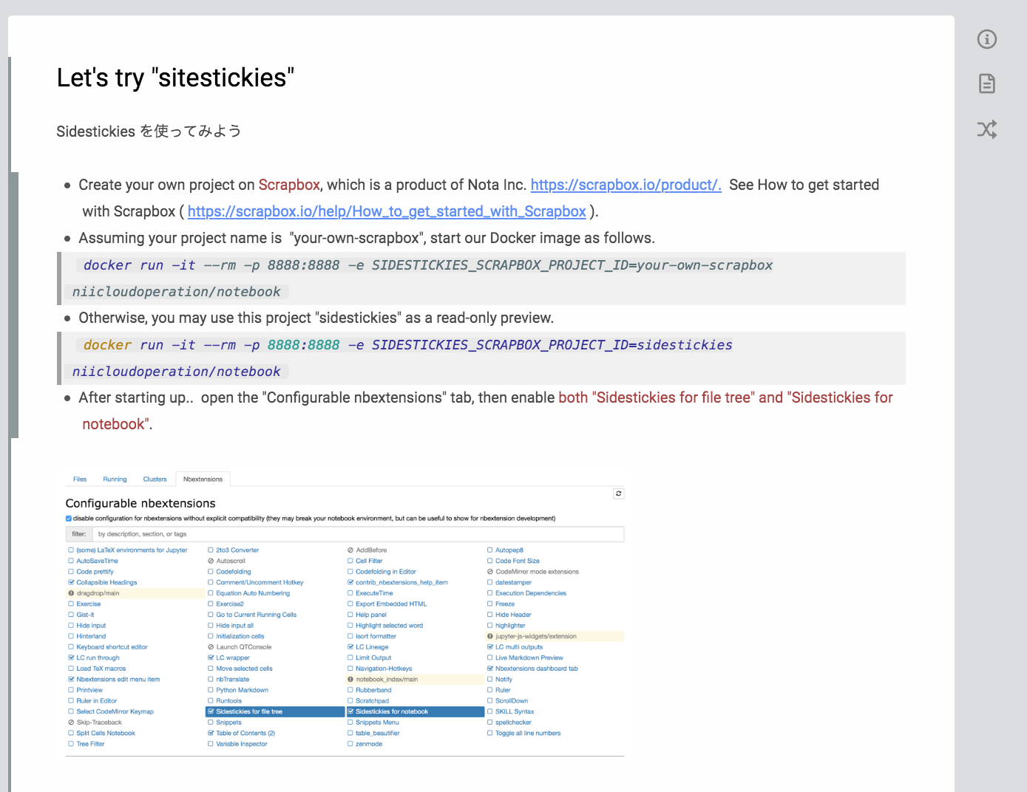
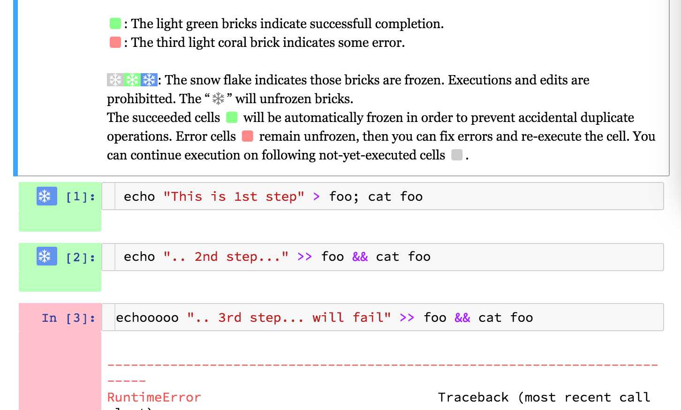
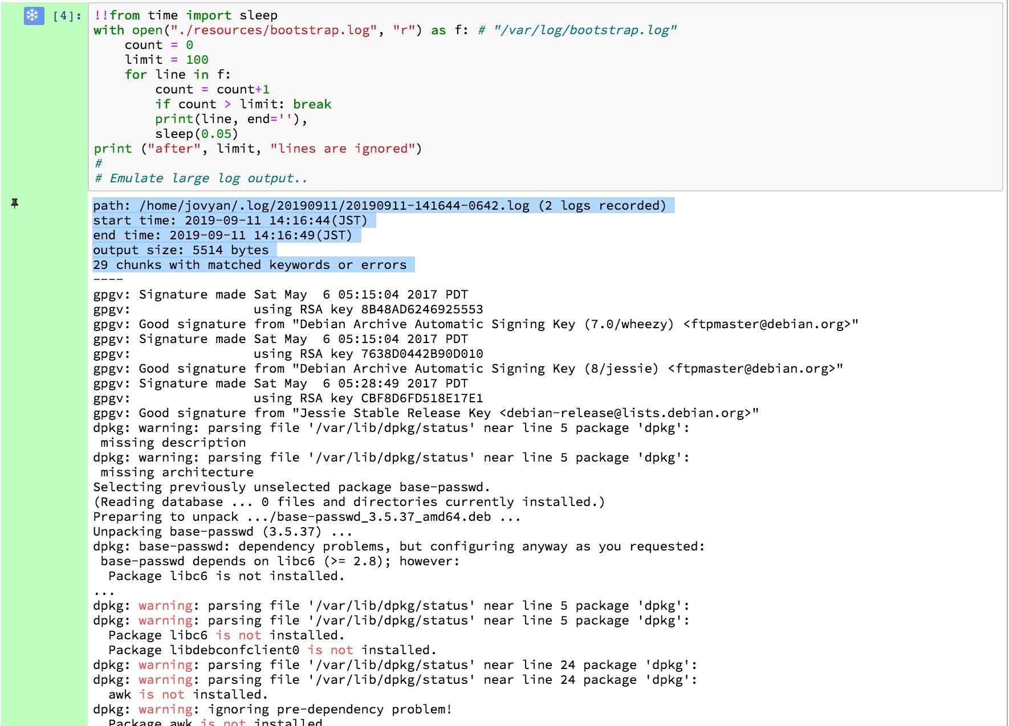
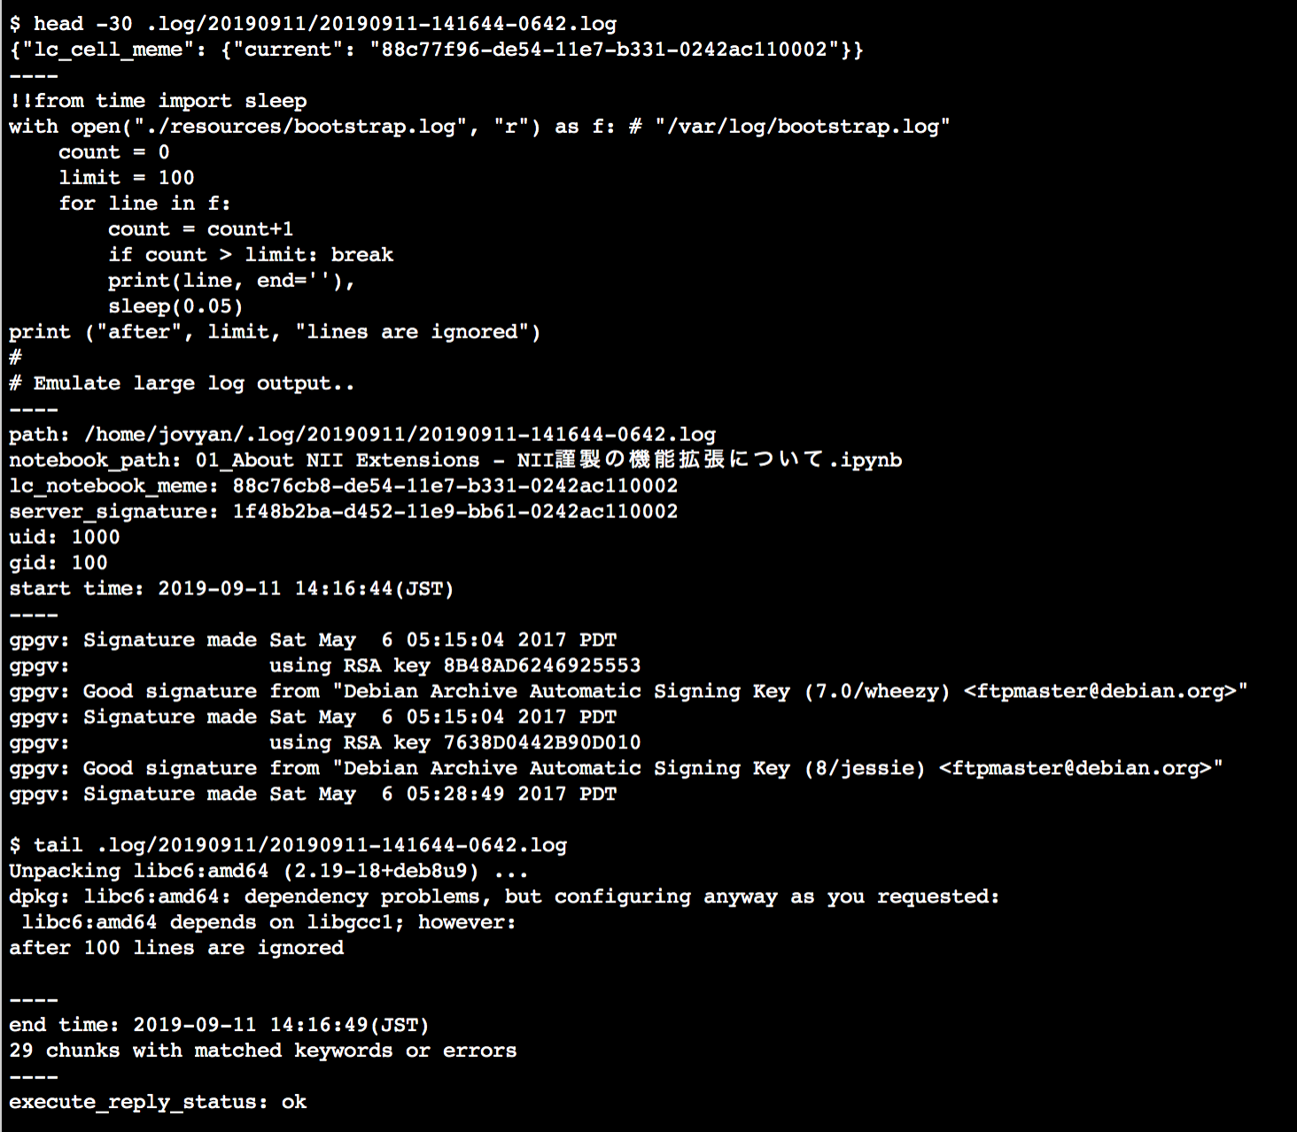
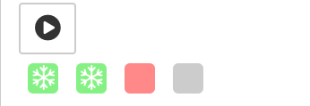

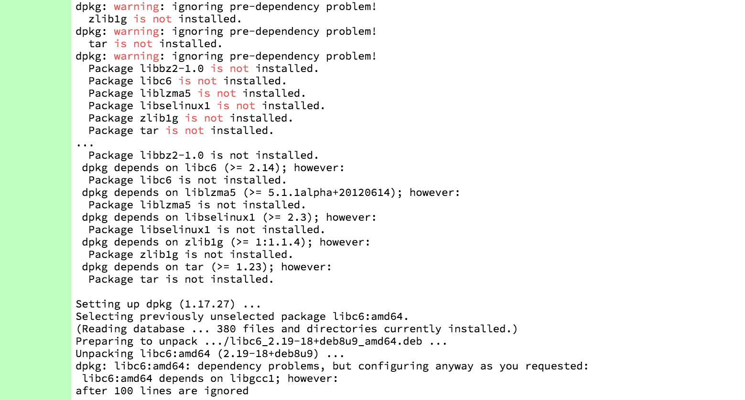
Reproducibility Extensions for Jupyter Notebook
Literate Computing for Reproducible Infrastructure
Literate Computing for Reproducible Infrastructure is our project, which utilizes Jupyter Notebook in the operational engineering area. The project seeks collaborative communication leading to share and improve operational workflows of researchers, educators, engineers, and other practitioners for reproducible computing. Jupyter Notebook enables us to describe automated operations with complementary principles, which aim to keep humans in the automated operational loop. We pursue resilient, human-centered automated operations (機械化) that should not excessively rely on no-ops automation (自働化).
Notebooks are machine-reproducible, human-readable, and substitutable procedures, which improve efficiency and robustness of operations without pushing aside humans from black-boxed automation. Keeping our ability to learn and grow, we can foster a resilient engineering team by encouraging sharing operational knowledge and developing skillfulness.
Reproducibility Extensions for Jupyter Notebook: Originally, Notebook is designed as non-linear explorative computing tools, typically for data scientists. Thus, we have developed extensions in order to assure IT admin’s robust and traceable system operations.
Enhanced Collapsible Headings
Collaborative Annotation
Represent “cells” under collapsed headings as “bricks”
Scrapbox.io is a powerful wiki service. Sidestickies link a cell with the pages of Scrapbox. It enables collaborative annotation, where your ideas and communications stay in context and grow.
Run through “bricks” as a whole with the “play button”
“note pages in Scrapbox”
“sidestickies”
Semi-Linear Operation
Audit Logs for Traceability
“a note page”
!! summarizes massive output lines
“bricks”
At each cell’s execution, store all original output lines into individual files with details
Try on MyBinder
head
errors
uid:
gid:
start time:
tail
end time:
https://mybinder.org /v2/gh/NII-cloud-operation/ Jupyter-LC_docker/sc-demo

